Slide 1
WELCOME

Slide 2
TOPIC: MEDI PLUS

Slide 3
INTRODUCTION: Medi Plus is a web portal developed using php as front end and MySQL as back end .This portal contains the information and location of all the medical stores in a particular locality which helps the user to search and filter out the medical stores near to them . The user can upload their prescription into the portal which can be viewed by the medical stores and they can respond to the user with the price quotation if the medicine is available. A user can also view all the details of nearby laboratories and blood banks which provide him overall information regarding any health concerned issues . Since the portal helps user in spotting the exact location of medical shops , medicine prices and all related data , it comes out as a user friendly entity.

Slide 4
ABSTRACT: The objective of the system is to manage the details of Customer ,Medicine Company ,Medicine ,stock and Order .It manages all the information about customer ,payment and order.

Slide 5
PROJECT DESCRIPTION: Human body is a very complex and sophisticated structure and comprises of millions of functions . All these complicated functions have been understood by man him , part-by-part their research and experiments . As science and technology progressed ,medicine became an integral part of their search . Availability of medicine in extreme times is equivalent to a human’s life . In case of an emergency ,a person’s life is at risk if there is a shortage of necessary medicines or related healthcare products. In this project , we are focussing on solving customer’s medical requirements wherein our portal will have all the medical shops in that particular area registered and with the help of this , any user can have access to find out information and availability of medicines in a particular store.

Slide 6
SCOPE OF PROJECT: The purpose of this portal is to automate the existing manual system so that it becomes user friendly as well . Project also provides access to user which is an additional feature wherein they can upload the prescription and get to know the details of all the stores having the prescribed medicines and also can get the quote from multiple stores and choose the best from among them . It also helps a user who is in urgent need of medicine and the medical store in the hospital is facing shortage of medicines , by helping them to spot the nearest store with availability of their required medicine . In this way, the project can serve a whole lot of people who are in emergency and can help save lives as well in a critical situation.

Slide 7
SYSTEM DESIGN: Design of a system can be defined as the process of applying various techniques and principles for the purpose of defining a device , a process or system is sufficient details to permit its physical realization . Thus ,system design is a solution a “how to” approach to the creation of a new system . This important phase provides the understanding and procedural details necessary for implementing the system recommended in the feasibility study.

Slide 8
SYSTEM TESTING: Software testing is a critical element of software quality assurance and represent the ultimate review of specification , design and coding . System testing is actually a series of different test whose purpose is to fully exercise the computer-based system . Although each has a different purpose , all of them work to verify that all system elements have been properly integrated and all of them perform allocated functions . If the test is conducted successfully , it will uncover errors in the software . A second benefit is that the software is appearing to be working according to specification and that performance requirements appear to have been met.

Slide 9
SYSTEM MAINTENANCE: Maintenance is a characteristic of design and implementation , which is expressed , as the probability that can an item will be retained in or restored to a specific condition within a given period of time , when maintenance is performed to accordance with the prescribed procedures and resource.

Slide 10
FUTURE ENHANCEMENT: In future , changes can be made by providing some provisions for online payments(e-payment) and also for delivery of medicines to user as per their requirement . The project has a very vast scope in future .

Slide 11
Proposed System
By considering the drawbacks in the existing system we have come up with the portal that helps to overcome this drawbacks .Our system consist of four modules: Admin, Medical store, User and lab. First of all, medical store, lab and user should register to this portal and admin has the power to accept their registration (medical store and lab). This improves the credibility of the system. Approved medical stores can add the details of all the medicines available in their medical store. Similarly approved laboratories can add and update their facilities to this portal. Users can upload prescription to the portal which the system directly routes all the medical shops. If the medicines are available the store can raise the price quotation to the user. User can then choose best quotation among them and proceed for them. User can also view details and location of all the laboratories and blood banks in the near vicinity. They can also post their feedback and raise complaints in the portal.
Advantages
Saves time and physical effort
Credibility is assured
User can view all the different rate of the medicine and choose the best among them

Slide 12
Existing System
In existing system there is no such application for purchasing medicines in online with Geo Location. Traditional way of purchasing is to visit the nearby medical shop or to visit online website of medical shop to place order for medicine. The major drawback of this traditional way is that to take physical effort to visit each one of the medical shop in search of medicine. And it also consumes a lot of time. There is a high chance that the prescribed medicine want be available in any of the outlet.
Limitations of Existing system
It is limited to an existing system.
It is a time consuming process.

Slide 13
5.4.1 Context level
Level 0 DFD of medi plus
ADMIN
ADMIN
MEDICAL STORE
MEDICAL STORE
MEDI PLUS
USER
USER
5.4.2 Top level DFDs
Level 1 DFD of medi plus
LAB
LAB
Module Management
ADMIN
ADMIN
Response to Request
MEDICAL STORE
MEDI PLUS
MEDICAL STORE
USER
Requesting for Medicine
USER
LAB
Requesting for Blood
LAB

Slide 14
Medical store management
1.1
Level 1 DFD of admin
Medi_shop
View complaint &feedback
ADMIN
Complaint
Login
ADMIN
User management
1.2
User_log
User_data
Lab management
1.3
Med_lab

Slide 15
Approve/ deny
Level 1.1 DFD of admin
medical store details
Medi_shop
medical store details
1.1
Medical store management
medical store details
Search medical store
medical store details
ADMIN
Level 1.2 DFD of admin
medical store details
Medi_shop
medical store details
Request/ respond
Add medical store
user details
User_req
user details
Medi_shop
1.2
User management
medical store details
Search medical store
medical store details
ADMIN
Medi_store
blood bank details
blood bank details
Search blood bank
Blood_bank

Slide 16
Approve/ deny
Level 1.3 DFD of Admin
lab details
Medi_lab
lab details
lab details
Search lab
1.3
Lab management
lab details
ADMIN
Level 1 DFD of Medical Store
Medi_lab
lab details
lab details
Add lab
Medicine management
medicine details
medicine details
Medi_lab
Medicine_data
LOGIN
View sales detail
Medical store
Medical store
sales details
sales details
User_log
user details
Sales_data
user details
Reply to user
User_send

Slide 17
Level 1 DFD of Lab
Manage facilities
lab facility details
lab facility details
LOGIN
Lab_facilities
Lab
Lab
lab packages details
Add lab packages
lab packages details
User_log
Lab_packages

Slide 18
Post complaint/feedback
Level 1 DFD of User
Complaint_data
complaint / feedback details
Post request
complaint / feedback details
request details
User_req
request details
Login
Search medical store
User
medical store details
medical store details
User
User_log
blood bank details
Medi_store
blood bank details
laboratory details
View blood bank
laboratory details
Blood_bank
View Laboratories
medi_lab

Slide 19
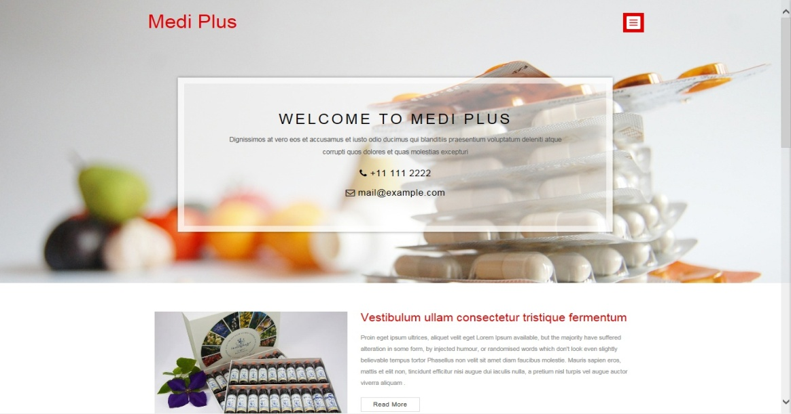
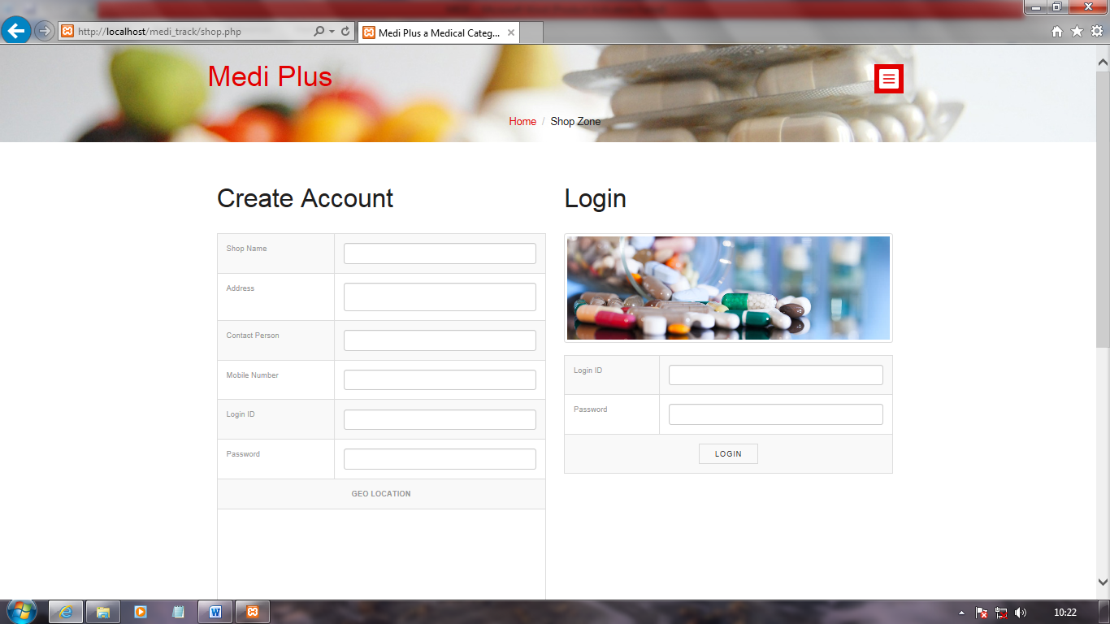
Screen layout
Home page
Shop zone

Slide 20
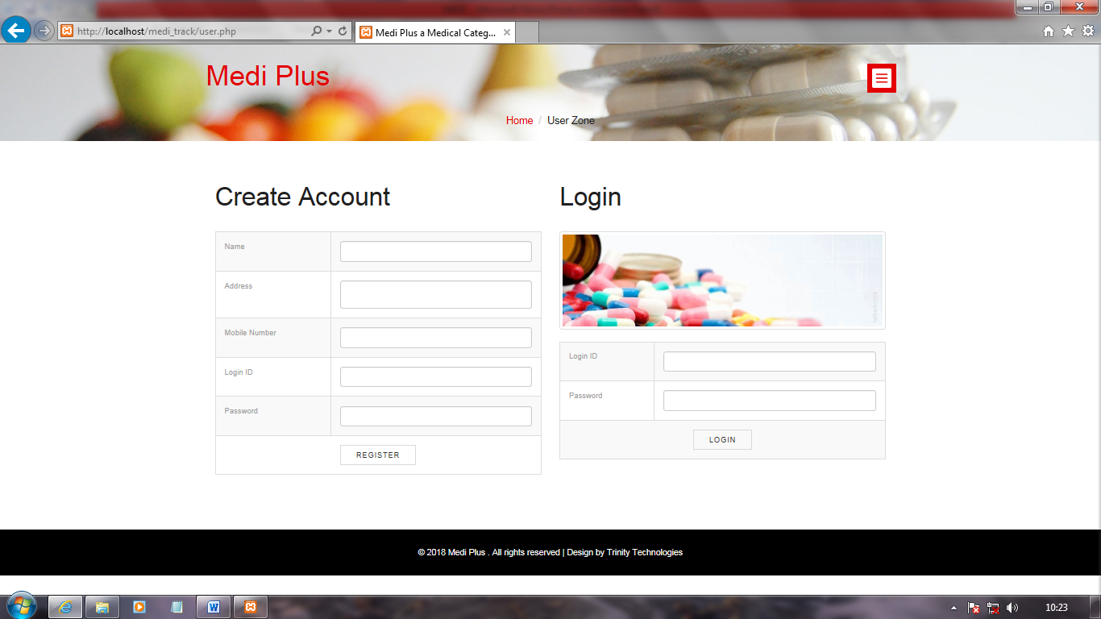
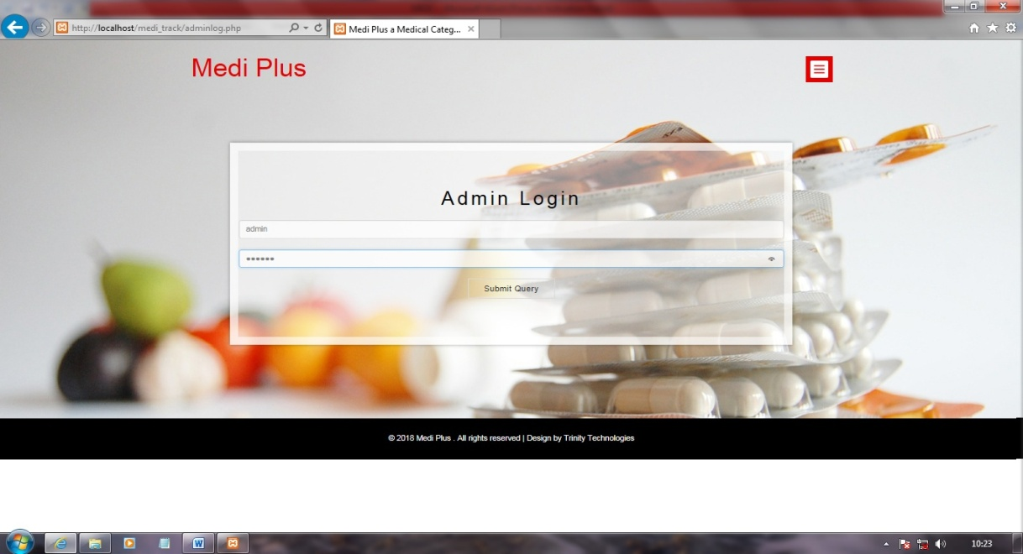
User zone
Admin login

Slide 21
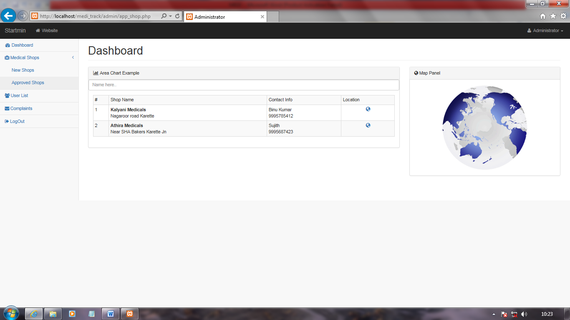
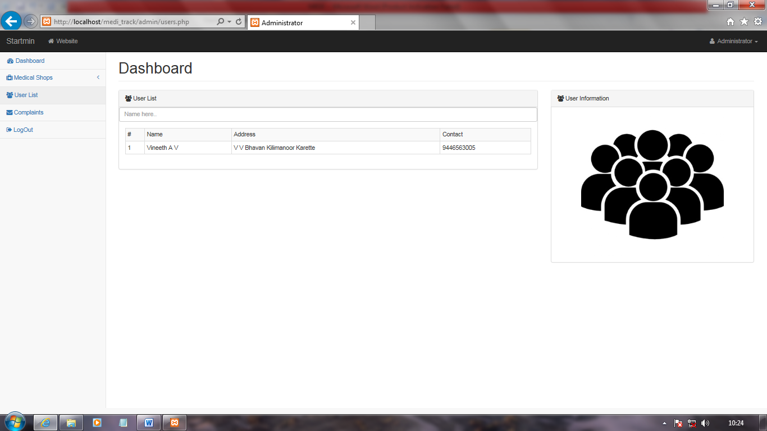
Approved shops
User list

Slide 22
CONCLUSION: In a nutshell ,it can be summarized that our proposed system is certainly way more efficient and effective than the existing system when viewed from a user’s point of view . The internet has become a major resource in modern business, thus medicine shopping has gained significance not only from the entrepreneur’s but also from the user’s point of view . Proposed system allows users to view all the nearby medical stores , laboratories and blood banks and moreover the availability of the medicines in the store ,which helps save time and physical effort of actually going out and purchasing medicines with the ambiguity regarding whether the medicine is available or not in the store .Also , user can choose among the quotations provided by different stories and select the best rate in market and this helps in satisfying user needs to the fullest.

Slide 23
THANK YOU

